Slide 1
System Identification to support and enhance Flight Testing
23.02.2018
A project proposal
Alejandro Valverde
Notes:
Hello everyone, my name is Alejandro Valverde and I have an idea. Idea which I would like to propose to you today.
For those of you already initiated in this topic, I would like to implement System ID techniques into the current Flight Testing methodology. I would do this in a:
Cost effective,
Efficient, and
Accurate,
ways. And in this presentation, I will describe how I want to do this.
Now, for those of you not initiated in this topic…

Slide 2
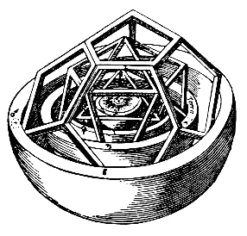
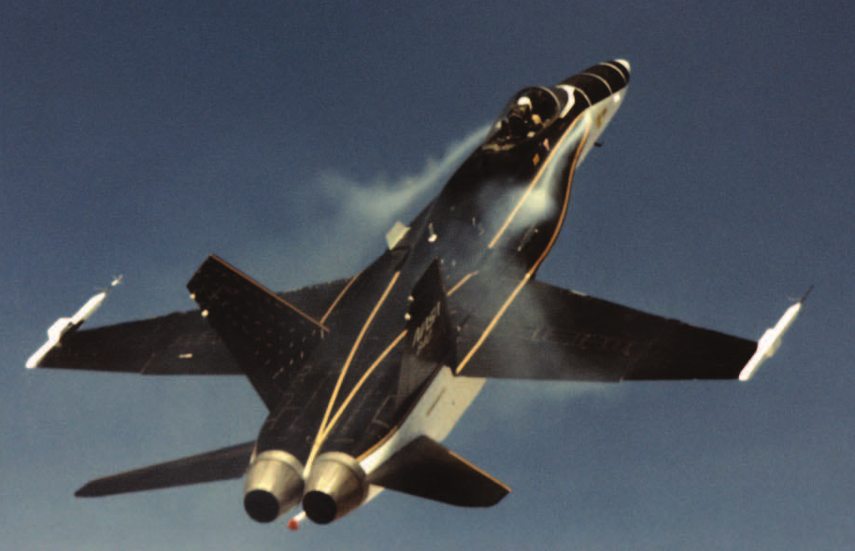
Aircraft System Identification
System Identification is the process of building mathematical models for physical systems based on imperfect observations or measurements
When applied to aircraft, it is called
Aircraft System Identification
@ Kopter Group AG | Alejandro Valverde
Notes:
One of the oldest and most fundamental of all human scientific pursuits is developing mathematical models for physical systems based on imperfect observations or measurements. This activity is known as system identification. When applied to aircraft, this is known as system identification.
And this is in fact one of the reasons why I am so interested in this topic, This discipline is fairly unknown in the aerospace industry, but it is in fact something that scientists and engineers have been doing for hundreds of years.
I like to recall know the contribution to human progress made by Johannes Kepler when, in 1609, he published the book Astronomia nova which presented a mathematical model that describe the motion of the planets in the Solar System. For this, he collaborated with the Swedish Tycho Brahe, who provided him with precise data of planets position in the sky. This was System Identification.

Slide 3
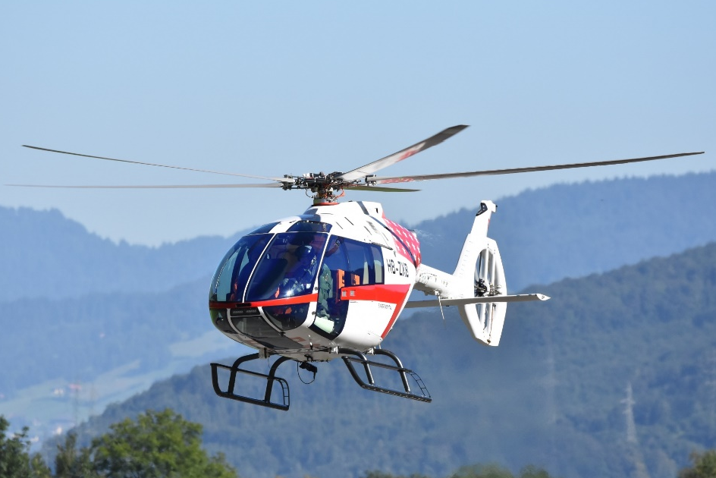
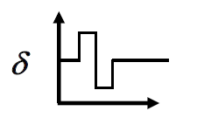
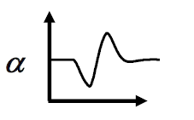
Problems in Aircraft Dynamics
Input, u
Output, z
System, S
Simulation: Given u and S, find z
Control: Given z and S, find u
Identification: Given z and u, find S
@ Kopter Group AG | Alejandro Valverde

Slide 4
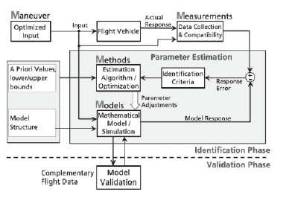

Slide 5
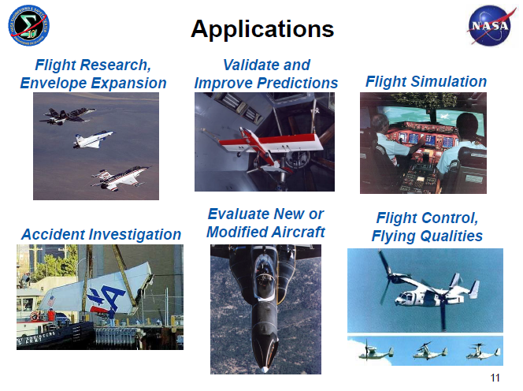
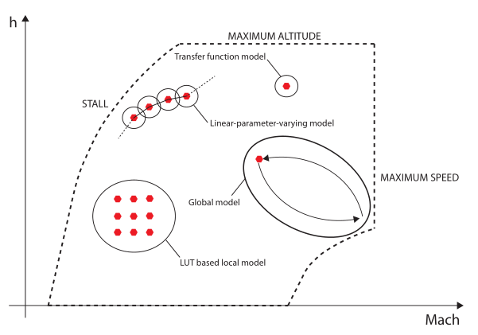
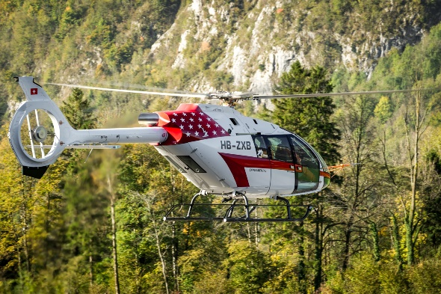
Applications of Aircraft System ID techniques
Aircraft System Identification offers a wide range of different applications, including:
Flight Simulator development
Flight envelope expansion
Picture of the flight simulator in the basement
Evaluation of new aircraft
Handling Qualities assessment
and enhancement
And many others…
@ Kopter Group AG | Alejandro Valverde

Slide 6
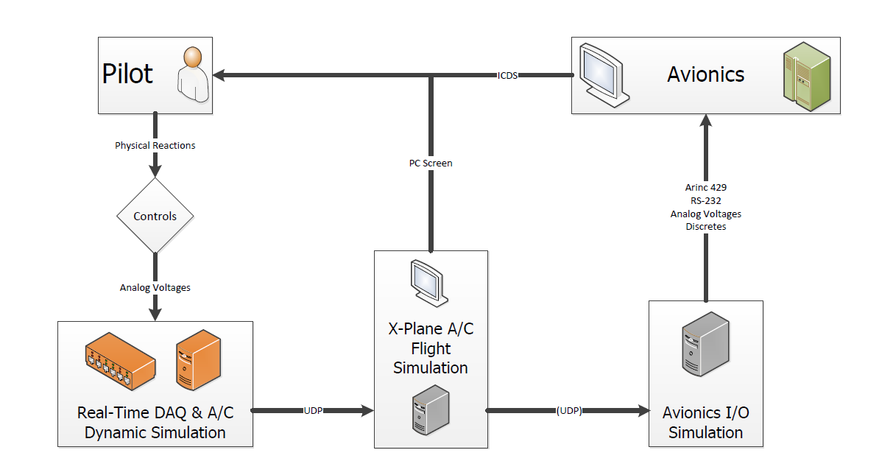
Aircraft Simulation - Ongoing Kopter project
Extracted from Nicolas’ MSc Thesis overview in collaboration with Kopter Avionics Dep.
@ Kopter Group AG | Alejandro Valverde

Slide 7
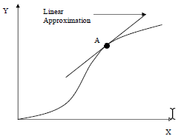
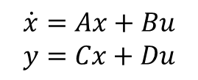
Aircraft Simulation – Current Kopter approach
Dynamic
Simulation
Trimmed condition of
FlightLab, e.g.:
Non-linear model
fwd level flight @ 100kts
Linear model
linearization of full H/C dynamics:
Suitable for:
FCS design
H/C flight simulation
Aircraft dynamic stability analysis
@ Kopter Group AG | Alejandro Valverde

Slide 8
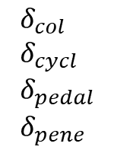
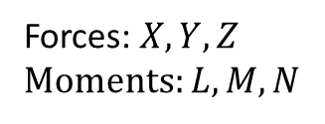
Aircraft Simulation – Current Kopter approach
Dynamic
Simulation
Non-linear model
Pilot
inputs
Aerodynamic, structural and propulsive
H/C model
Equations of Motion
Forces:
Moments:
System ID provides an accurate, simple and reliable model of the H/C dynamics
obtained from real flight test data of the real H/C
LUTs
@ Kopter Group AG | Alejandro Valverde
Notes:
Accurate -> Because it’s based on real flight data
Simple -> Does not require high computational power
Reliable -> Computed with

Slide 9
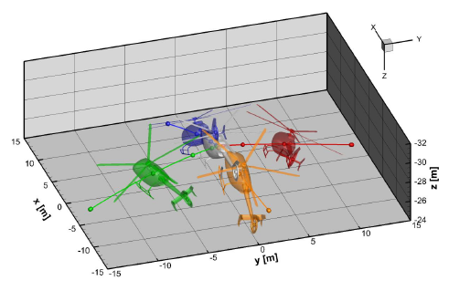
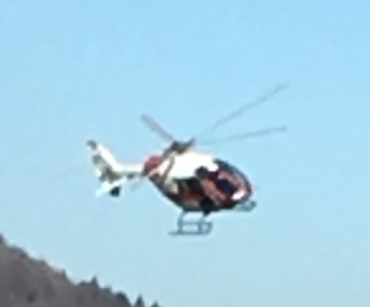
System ID R/C Model vs FlightLab
H/C model from System ID
FlightLab H/C model
Advantages:
High accuracy
Validation -> instantaneous
Non-linear flight dynamics
Transient flight conditions
Real-time dynamic modelling
Drawbacks:
Depend on flight test data availability
Advantages:
Not dependent on flight test data
Drawbacks:
Validation -> complicated
Only linear flight dynamics
Best use: Dynamic model of the
real H/C
Best use: Loads prediction
@ Kopter Group AG | Alejandro Valverde

Slide 10
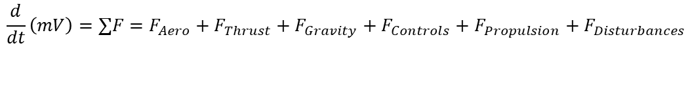
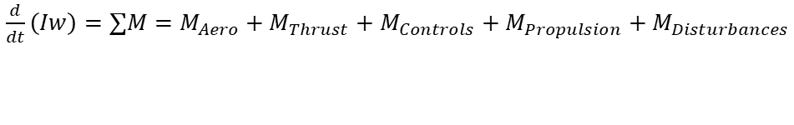


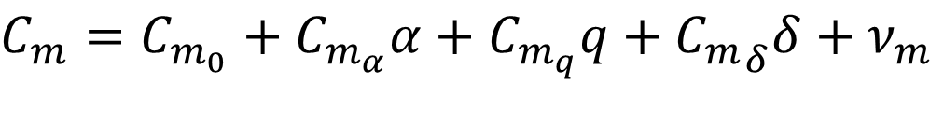
How does it work?
Forces and moments
Develop a model form from which parameters can be estimated using flight test data
for example, using Taylor series expansion
Pitching moment coefficient
longitudinal angular velocity
H/C angle of attack
pitch control input
pitching moment bias
static stability
dynamic stability
(damping)
pitch control authority
@ Kopter Group AG | Alejandro Valverde

Slide 11
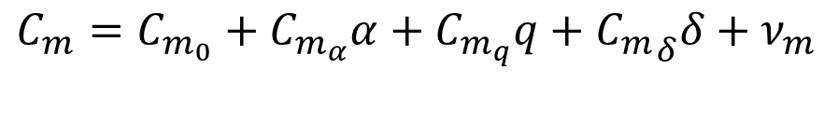
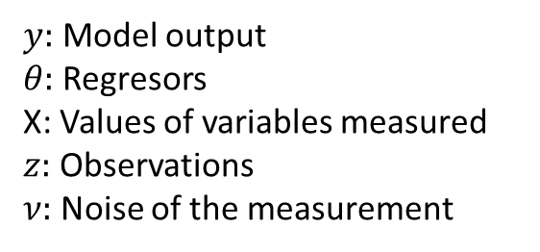
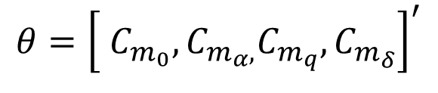

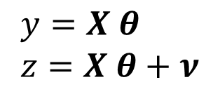
How does it work?
Pitching moment model:
Model output
Regresors
X: Values of variables measured
Observations
Noise of the measurement
Vector of regressors (parameters to be identified)
Observations
Model:
- Simple
- In flight on fly estimations
Equation-Error
Solved in one-shot linear algebra
two approaches
Solved with iterative nonlinear optimization
- Any nonlinear system dynamics
- Machine learning
techniques
Output-Error
@ Kopter Group AG | Alejandro Valverde

Slide 12
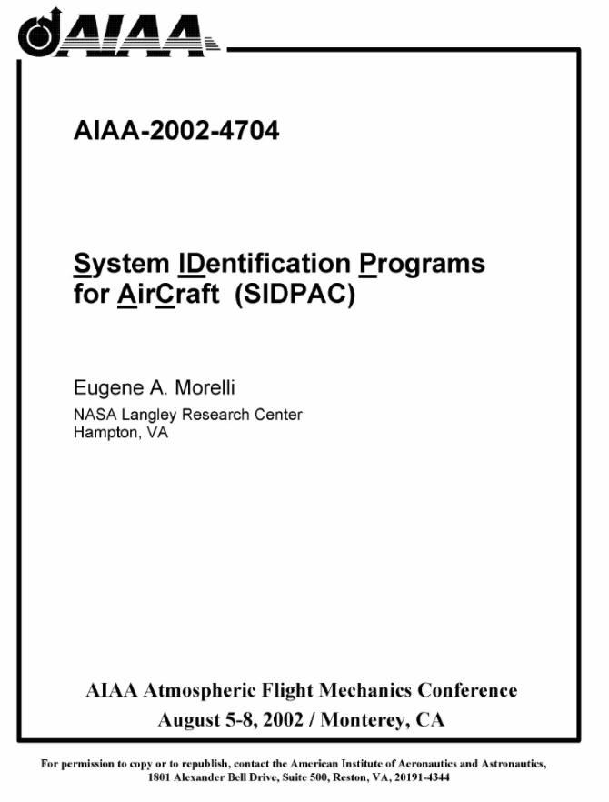
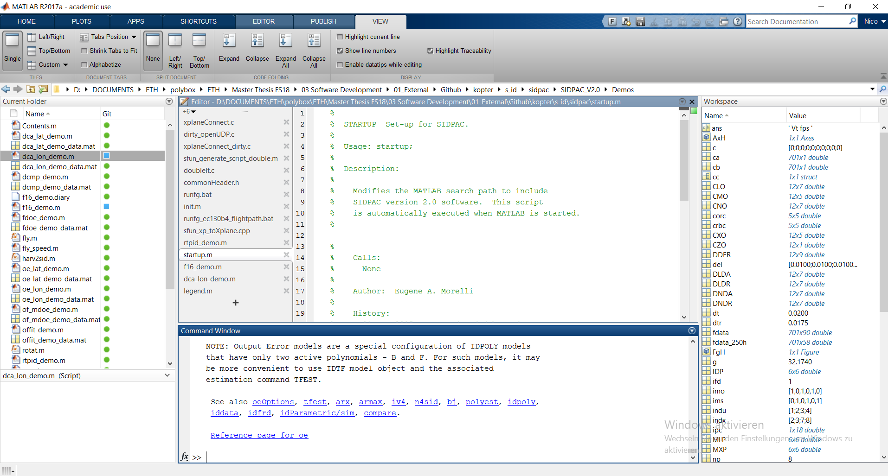
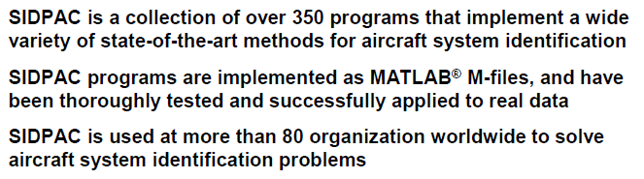
Tools – SIDPAC software
Already available
No development time needed
Proven industry suitable software
Further ways:
    Python implementation
@ Kopter Group AG | Alejandro Valverde

Slide 13
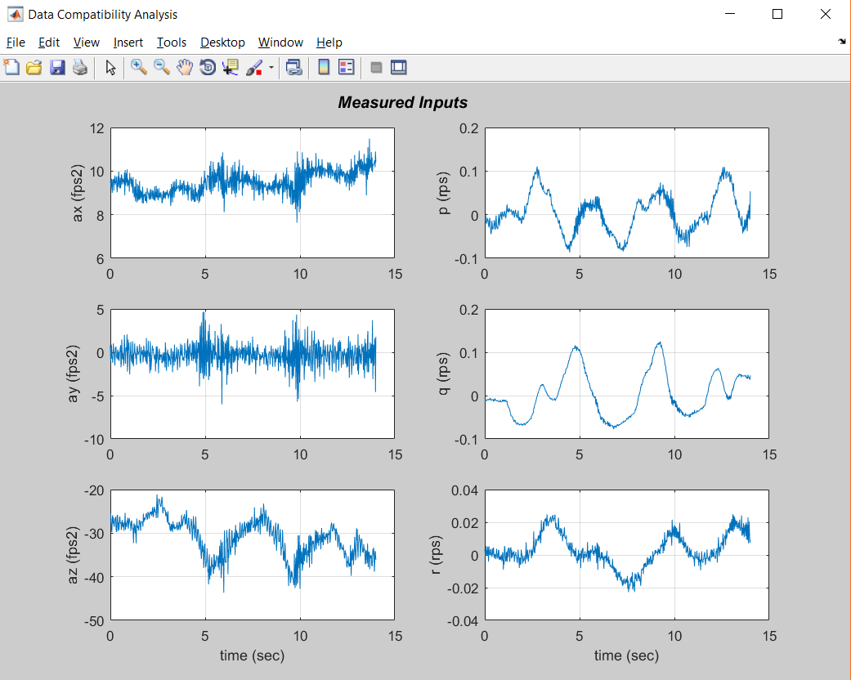
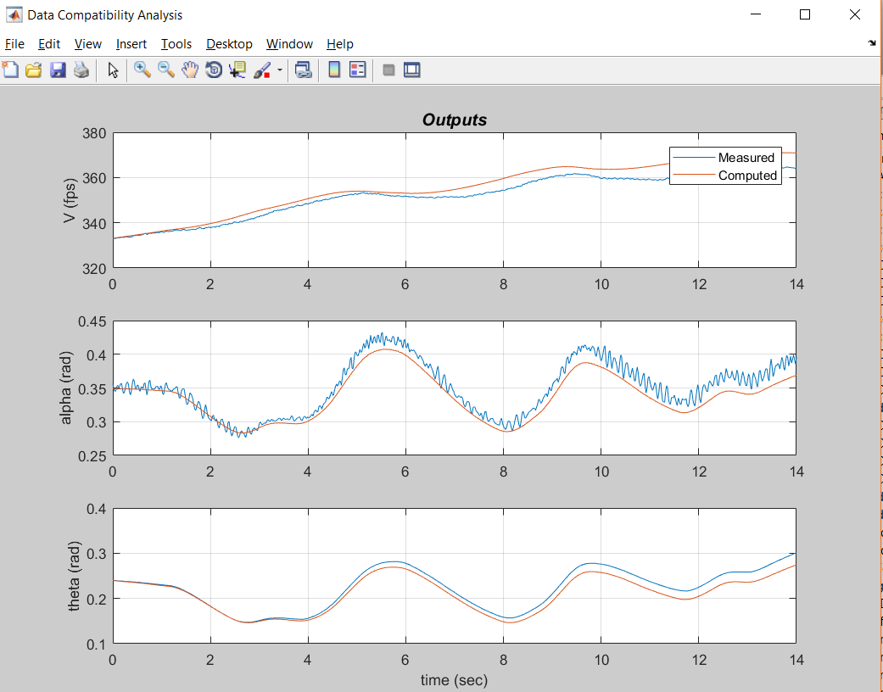
Tools – SIDPAC software

Slide 15
What would I need?
some accelerometers installed in P3, a part from the usual instrumentation… -> we already have this
A laptop
Some coffee
@ Kopter Group AG | Alejandro Valverde

Slide 16
Why to introducing System ID into P3 test campaign?
Sooner or later –> Every big helicopter manufacturer has SID implemented
Assist P3 flight envelope expansion
Provide a propor dynamic model of the H/C
for the simulator
Cost effective
Surely it will be need for PS4 and further developments
after TC
System ID takes time and money – but not nearly as much as not doing it
Eugene A. Morelli
NASA Langley Research Center Hampton
We have to do it now,
we are ready now
@ Kopter Group AG | Alejandro Valverde
Notes:
About Morelli:
Definitely explain who E. Morelli is.. NASA's go to guy for System Identification.. I like the story about the hypersonic vehicle that the US flew from somewhere off the west coast of the USA, where the craft took 13 minutes to reach Australia.. Morelli was given 30 seconds of that 13 minutes to put inputs into the control surfaces in order to assess the flight dynamics

Slide 17
Why I can be the one doing this?
Young <-> Passionate
I know what to do and how to do it
Kopter experience
Data analysis experience
        Python
        Matlab
        Data analysis and machine learning techniques
        …
@ Kopter Group AG | Alejandro Valverde

Slide 18
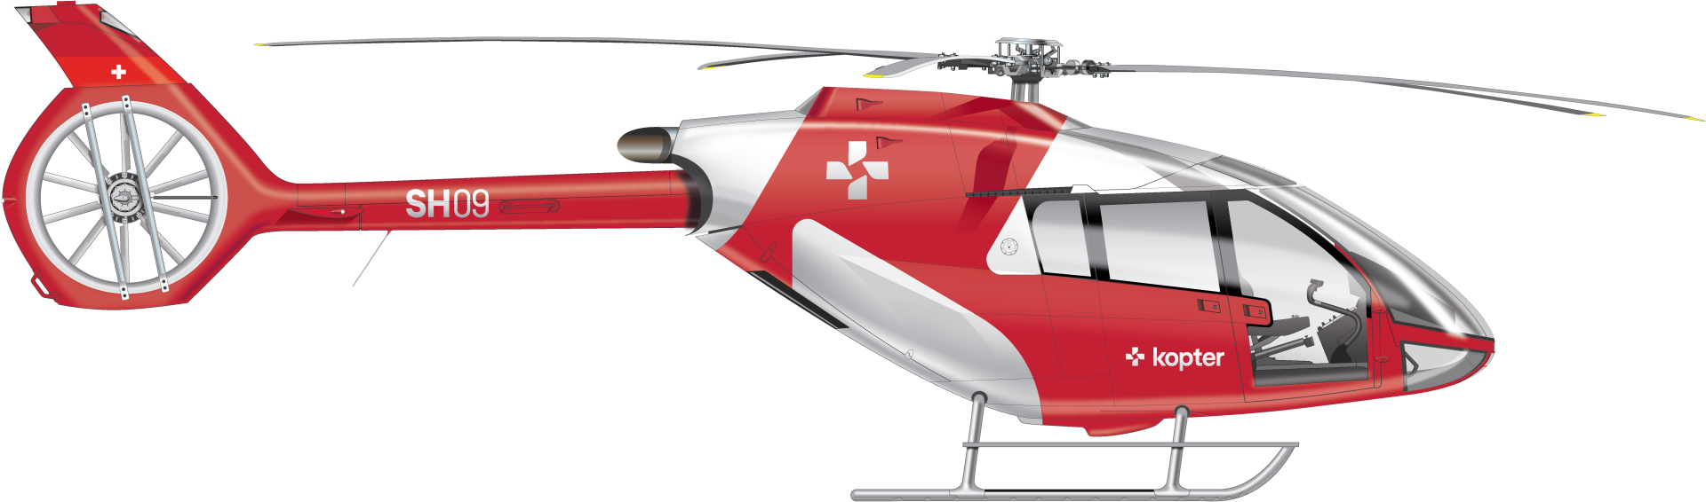
@ Kopter Group AG | Alejandro Valverde

Slide 19
Thank you

Slide 20
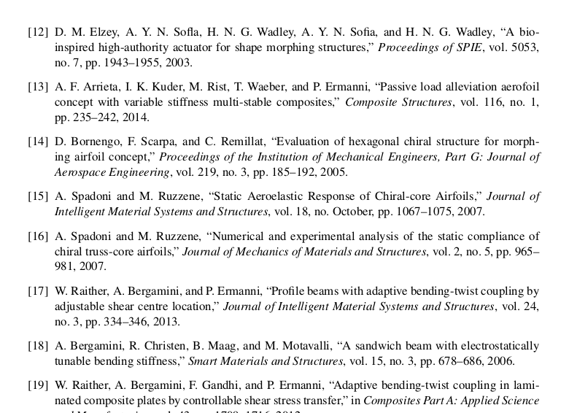
References
[1]: Aircraft System Identification. Theory and Practice.
@ Kopter Group AG | Alejandro Valverde

